Slide 1
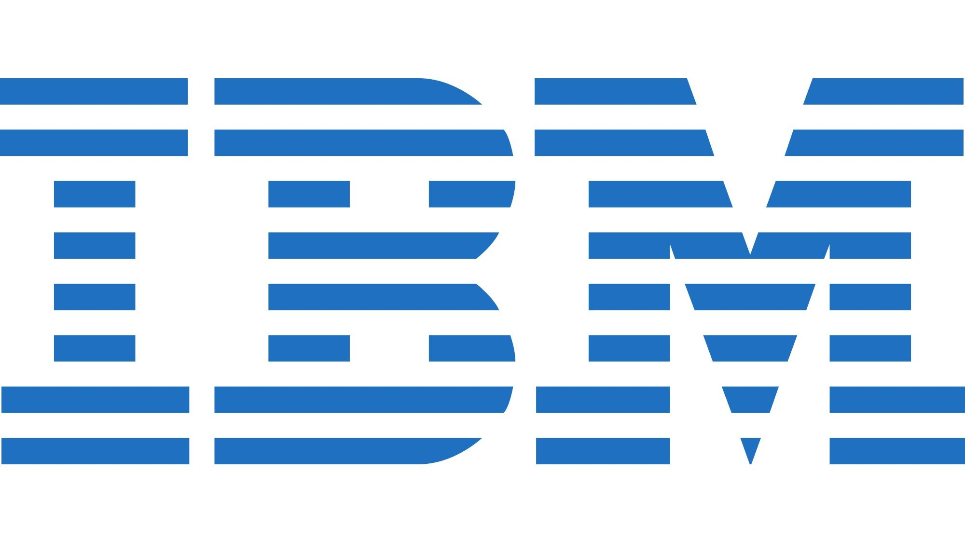

A General Overview of AWS
By Mark LaGrone put together for the benefit of the IBM PM/BA group

Slide 2
Topics Covered
Common Uses, Advantages of Cloud
What is AWS?
Is AWS a SaaS, PaaS, or IaaS?
AWS Basics: Tools, Building Blocks, Containers, Instances, Services
Tools
AWS Build Considerations: Deployment, Managed or UnManaged, Purpose
AWS Deployment Considerations: Tools and Strategies
Monitoring
Optimization
Storage, HW, Network Resources
Containers
Microservices
SQS, SNS, Lambda, Streams
Auto Scaling/Load Balancing

Slide 3
Some Common Uses for Cloud
iNetBackup.com - Backup to cloud (or Store to Cloud)/ Retrieve from Cloud – Scalability, virtually Unlimited Storage
Jibjab.com, convertToPDF.com - File Transformation Services
GoDaddy.com - Website hosting
Iberiabank.com, Chase. Com - Front-end to order taking system that integrating to Monolithic ERP
Desktop Hosting (Citrix like interface to desktops – way of future, particularly after 5G established)
IT Management Platforms - Service Catalogues, Monitoring, AV Mgmt, Health Statistic Monitoring
YouTube, Pandora, Spotify, Hulu – Secure Storage and downloadable libraries of material
Facebook, Twitter, Instagram - Social Media Platforms
Siri, Alexa, Google Home - Hosting Natural Language response systems
Back Office Hosting (Email, Office 365, Conferencing, IM (Slack), TimeEntry, etc…)
SaaS – eTrade, JIRA, Amazon.com, SFDC, ServiceNow, Gmail, Google Maps,
PaaS – ServiceNow, Office 365
IaaS - Google Cloud, IBM Cloud, Azure, AWS
Ingesting all your unstructured and structured data into a Data Lake, or Data Warehouse or Data Mart for cognitive and/or analytics processing

Slide 4
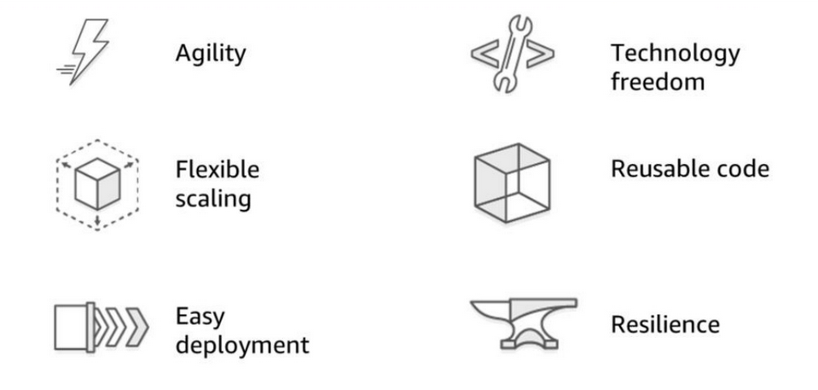
Advantages of Cloud Computing

Slide 5



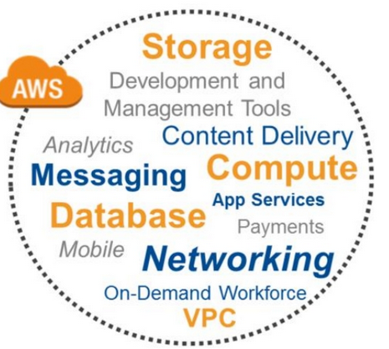

What is AWS? What AWS is NOT!
Amazon Web Services (AWS) is a subsidiary of Amazon that provides on-demand cloud computing platforms and APIs to individuals, companies, and governments, on a metered pay-as-you-go basis.
AWS is not:

Slide 6
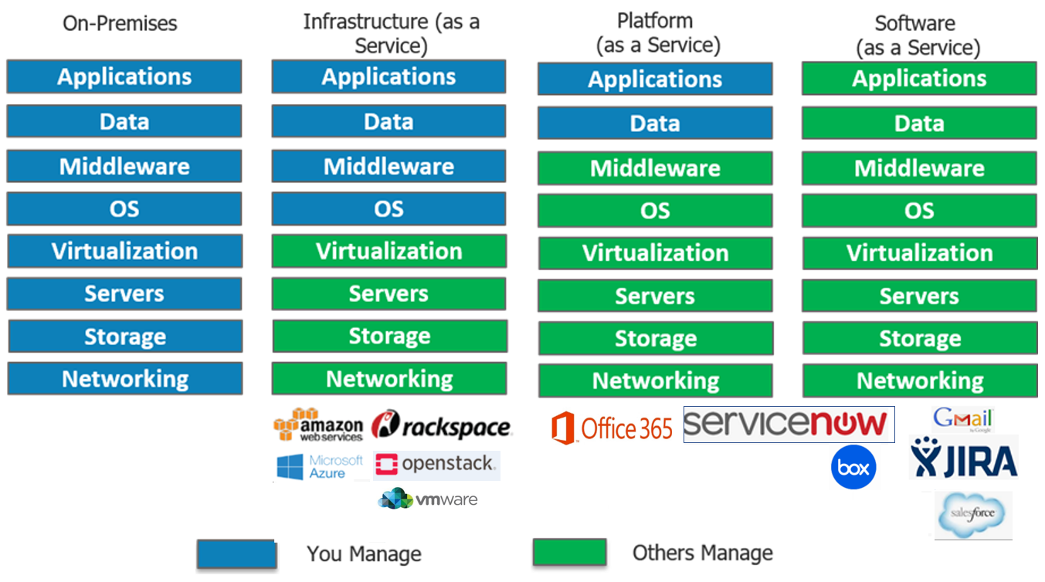
Amazon is an IaaS, a PaaS and even a SaaS
Virtual Machines
Anything Storage
AWS Dynamo
AWS App Services
AWS SQS
AWS SNS
Your Accounting System
Your Application Servers
Your Storage Systems

Slide 7
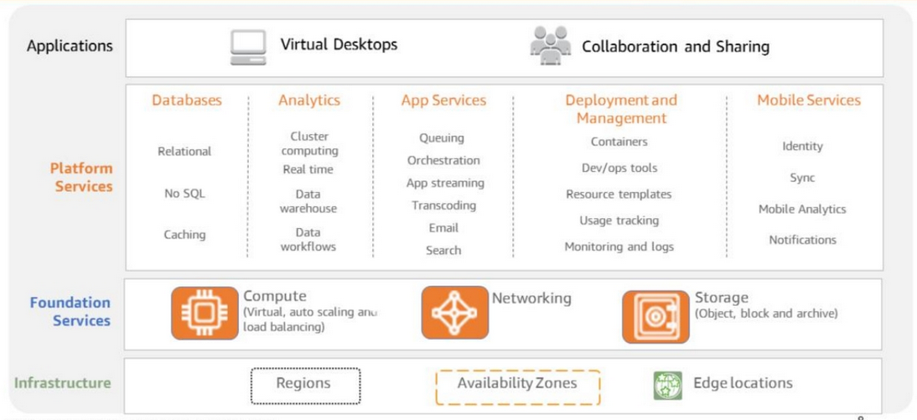



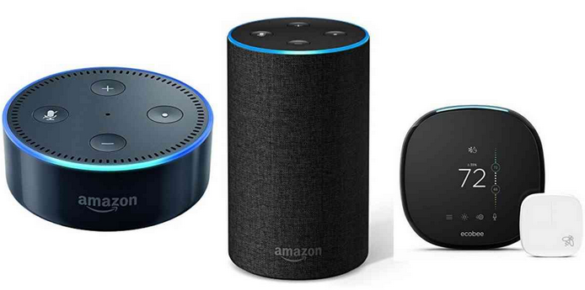


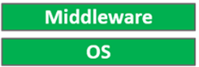
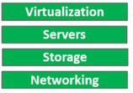
AWS Various Levels of Service Offerings
SaaS
Alexa
PaaS
IaaS

Slide 8
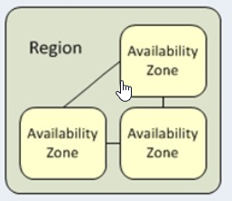
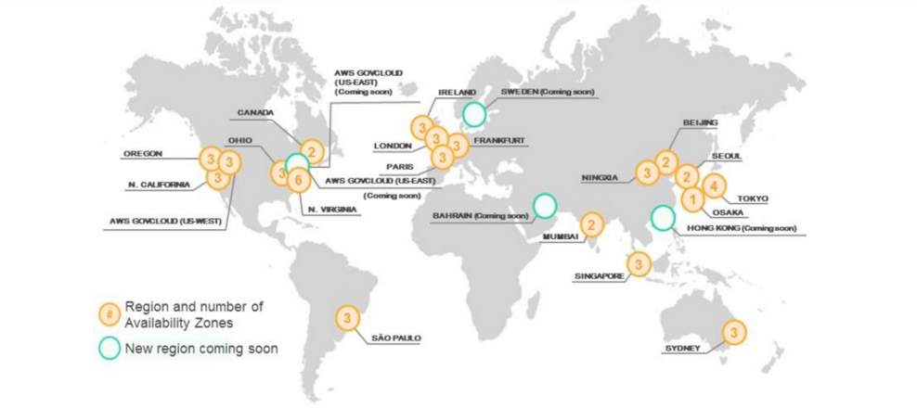
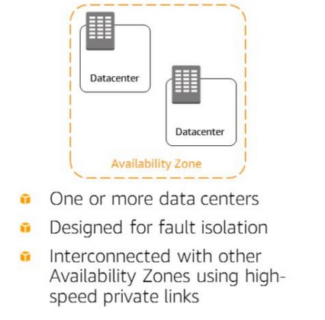
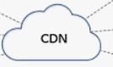
AWS Infrastructure – the Region, AZ, Edge
Edge
Each Region contains multiple redundancy linked Availability Zones (AZ)
Each Availability Zone is comprised of one or more linked Data Centers (DC)
Edge is an external connect point at a DC that you connect into cloud
*CDN – Content Delivery Network

Slide 9
AWS Basics
AWS Tools
AWS Management Console
CLI
SDK
AWS Building Blocks: Storage, COMPUTE, Networking
AWS Building Blocks: Containers and Services
Instances
Application and Platform Services

Slide 10
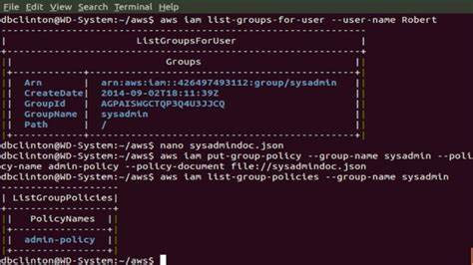
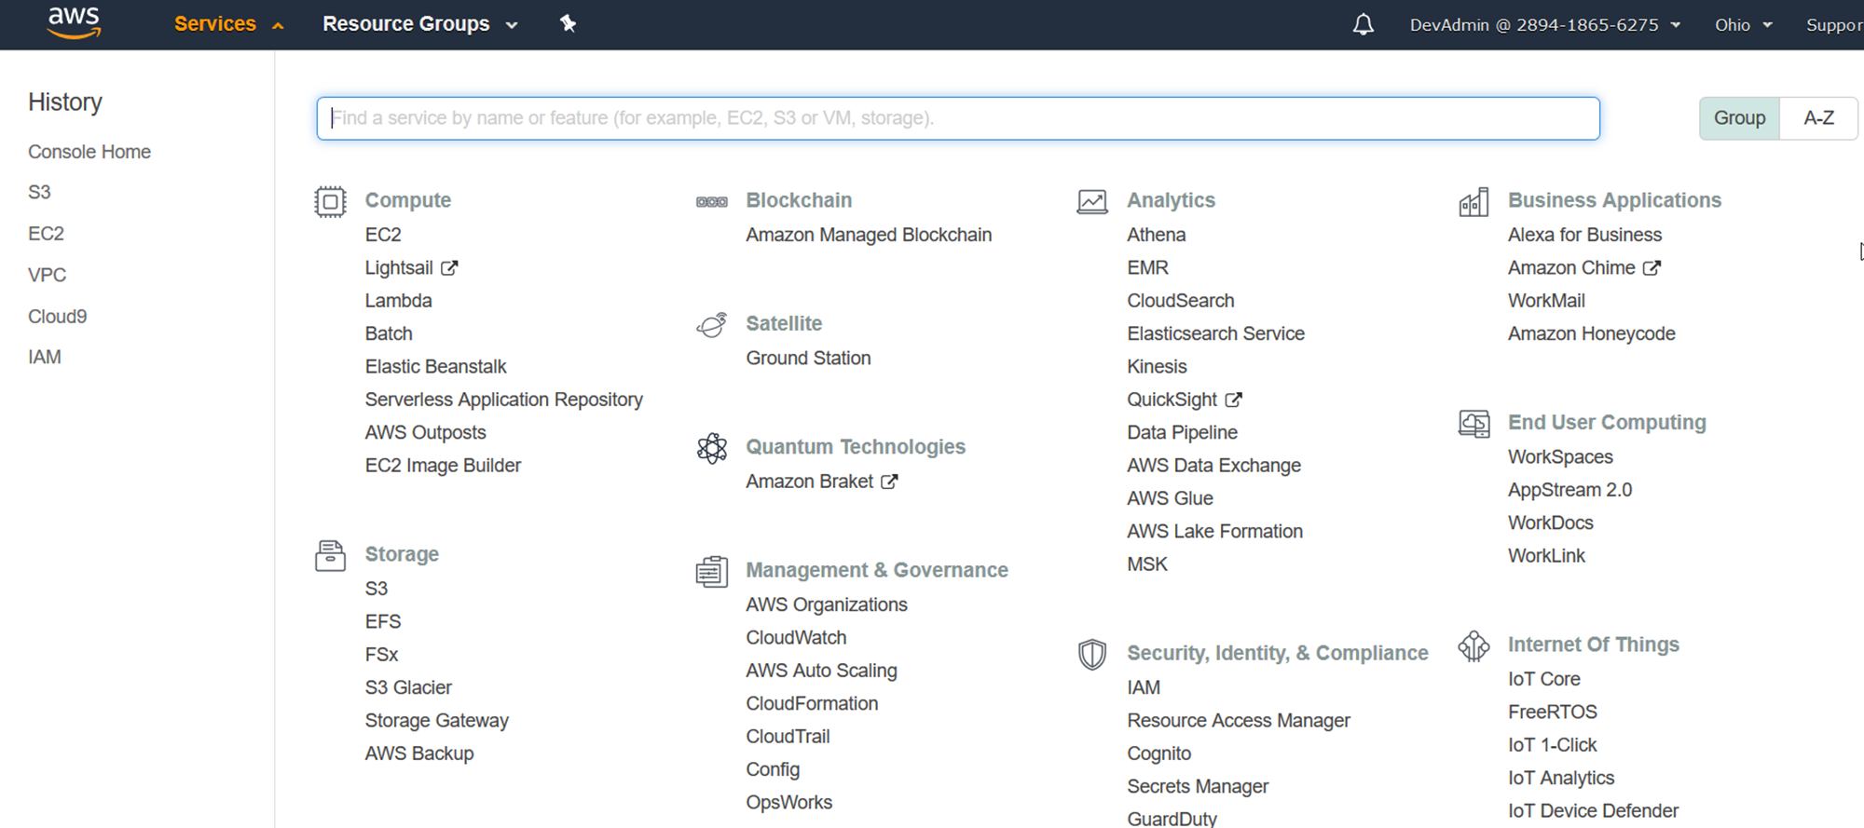
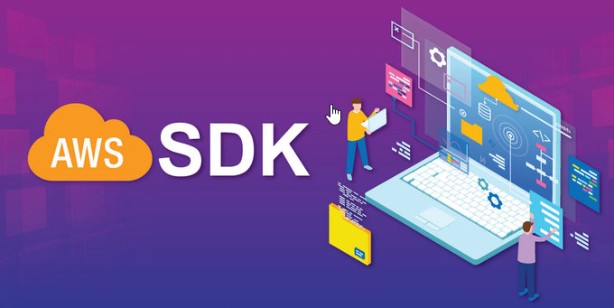
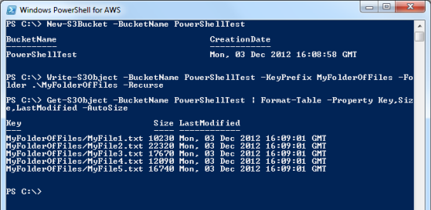
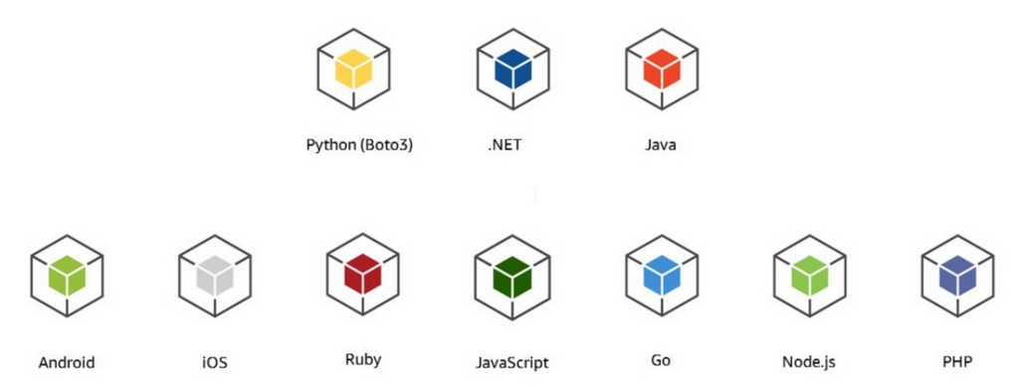
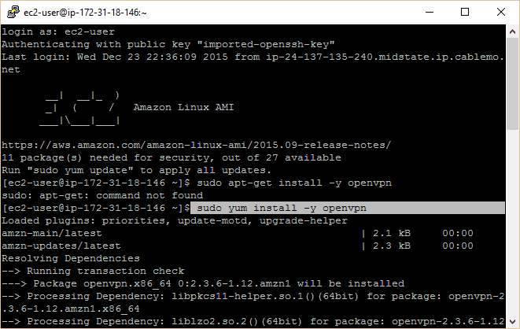
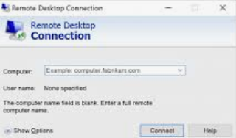
AWS – The Tools – Everything via API Calls
Command Line Interface (CLI)
AWS Management Console
AWS SDK
Contains API calls to AWS

Slide 11

AWS Management Console

Slide 12
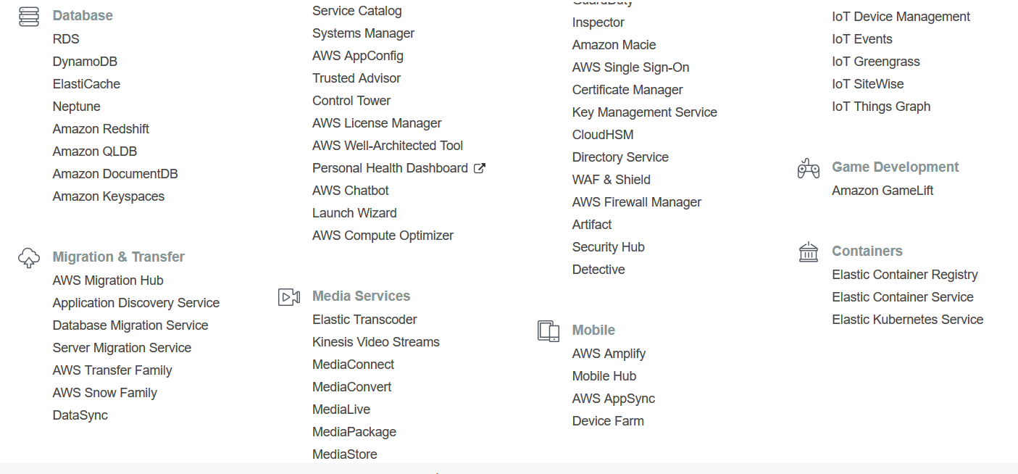
AWS Management Console - more

Slide 13
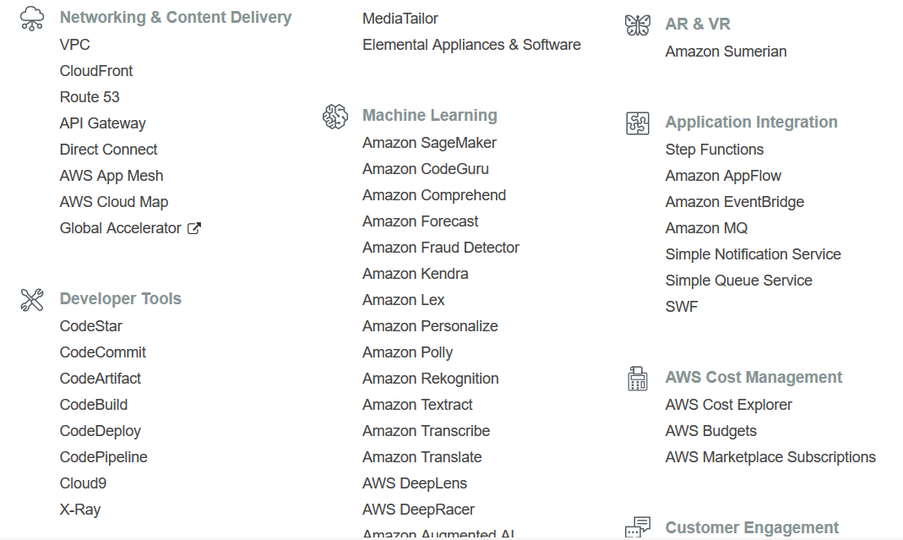
AWS Management Console - still more

Slide 14
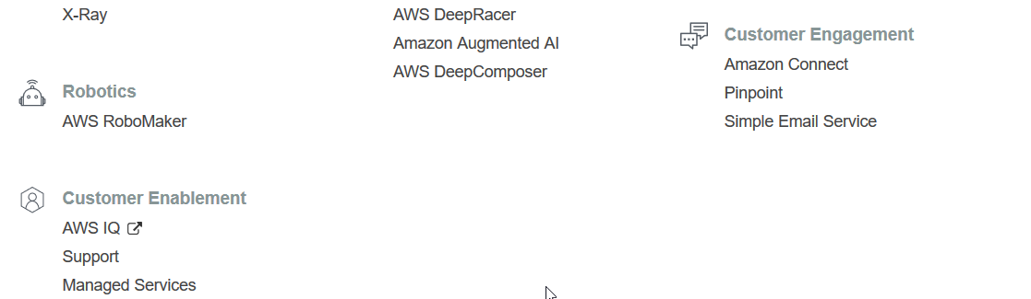
AWS Management Console - final
Plus, there are hundreds of other tools, customizations of these tools from AWS NOT listed as well as from other vendors that can be picked up in the AWS Marketplace

Slide 15

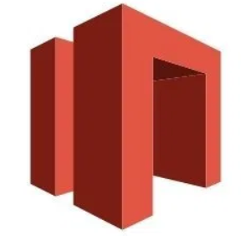

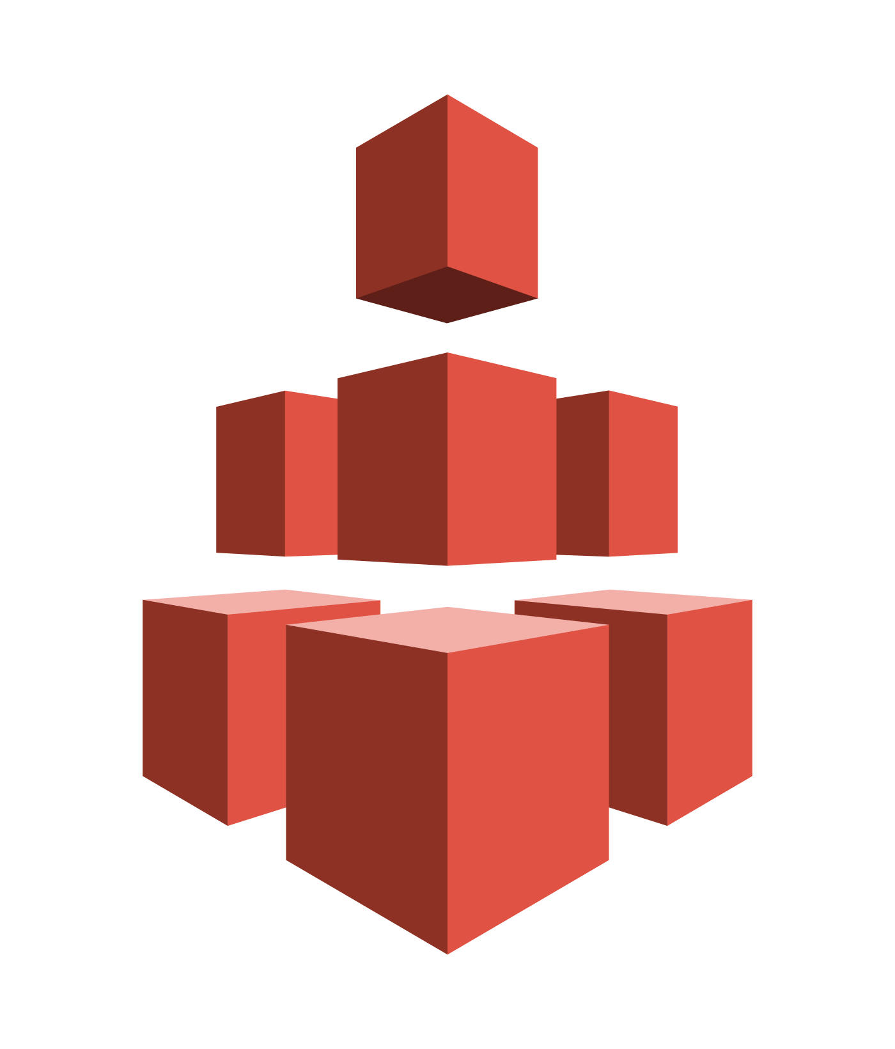


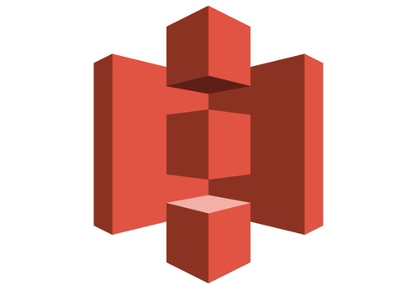

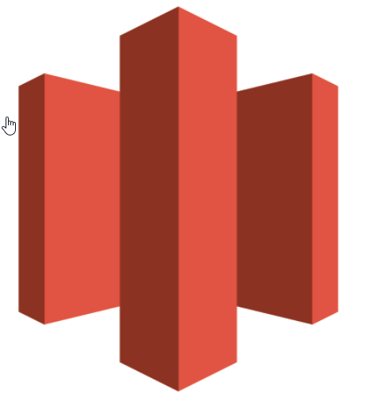


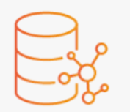

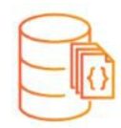

Building Blocks Storage
AWS SERVICES
ElastiCache
Storage Gateway
BLOCKS
FILES
OBJECTS
Bucket
CloudFront
Amazon RDS
Glacier
(Archive)
SQS
DynamoDB
Neptune
Elastic Block Storage
EBS
Elastic File Storage
EFS
Elastic Object Storage
Simple Storage Solution
S3
Network-attached
Volumes that provide
durable block-level
Storage for EC2 instances
SNS
DocumentDB
Redshift
Scalable network file
Storage for EC2 instances
Scalable, highly durable object
storage in the cloud

Slide 16
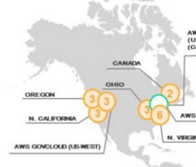
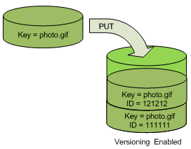
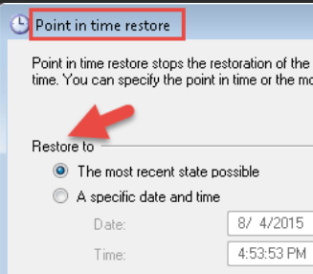


Storage Resiliency
Note: Developer only maps to
to Region. AWS does the rest.
REGION: US East (N. Virginia) us-east-1
Undisclosed Availability Zone
Undisclosed DataCenter
Undisclosed DataCenter
Amazon RDS
Amazon RDS
(MySQL)
(MySQL replica)
S3
Versioning
PITR
Or
Amazon RDS
Snapshot
Snapshots

Slide 17

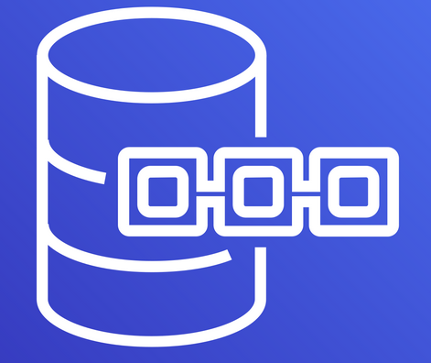
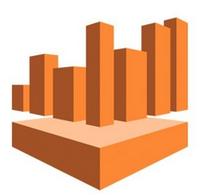
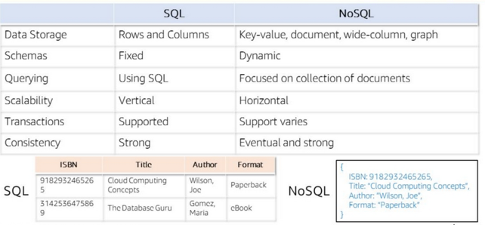


Database Types
Relational
Non Relational (NoSQL)
Relational /
SQL DB or services
Non-Relational /
NoSQL DB
TimeSeries DB
Ledger DB
{ MySQL, PostgreSQL,
Oracle, MS SQL Server,
MariaDB, Aurora }
SQL Based Query
Service for S3
Amazon RDS
DynamoDB
TimeStream
QLDb
Data Warehouse
Document DB
Graph DB
Athena
DocumentDB
Neptune
Redshift
In-Memory Data Store
Aurora
Elasticache

Slide 18
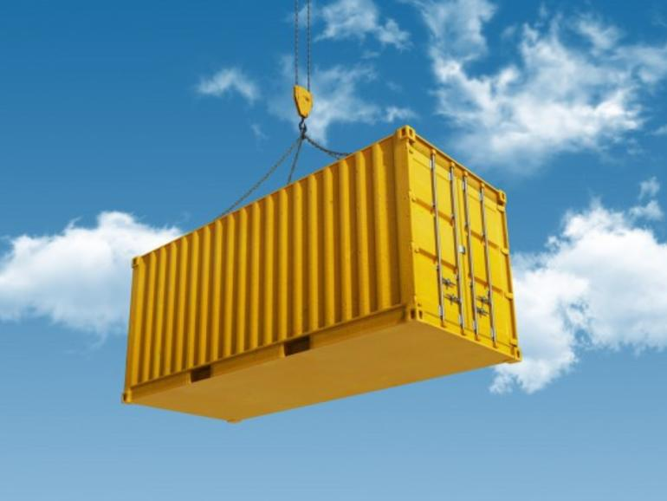
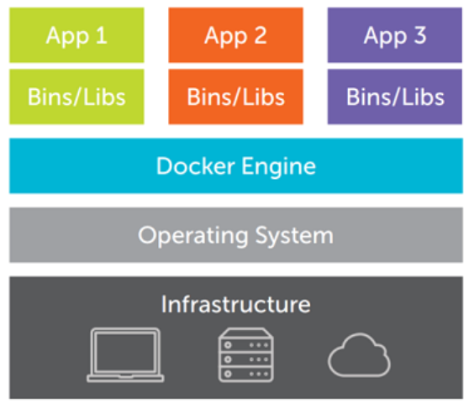
What is a Container?
Container
Container
Container
App Server
App Server
DB
AWS ECS /
/ Kubenetes
Host
Containers are Platform independent: IBM Cloud, AWS, Google Cloud, Azure
This is what enables multi-cloud capability, but not interactivity between clouds

Slide 19
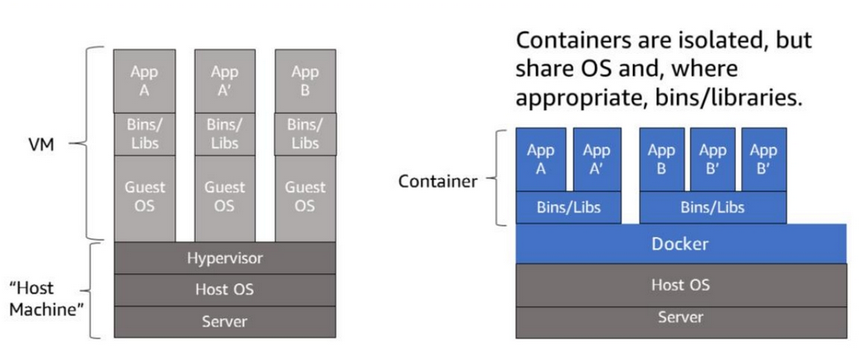

How is a container different from a VM?
Container Engine - deploys, manages, scales and does LB
Container Enginee
AWS ECS /
/ KUBERNETES
“Host Machine”
Infrastructure
Infrastructure
Storage, Network, COMPUTE
Storage, Network, COMPUTE
VMs don’t scale well.
VMs are much “heavier” than containers.
Containers are like mini-VMs, or more appropriately, like a process
Containers are isolated, but can share bins/libraries

Slide 20
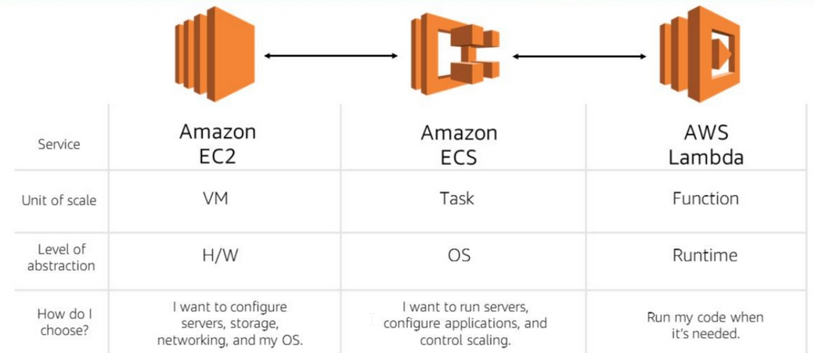
Architectural Evolution
Elastic Cloud Compute
EC2 Container Service
Serverless
Note on
Container Mgmt:
-Deployment
-Redundancy
-Scaling Up or Down
-Load Balancing
-Health Monitoring
-Service Discovery
-…and more
Costs
Pay for Resources Consumed
Pay for Resources used
Pay only when used
Scope
Container(s)
Container Mgmt
(Orchestration)
Amazon Managed
Management
You
You with Toolset
AWS

Slide 21
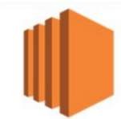
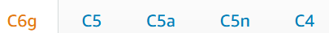
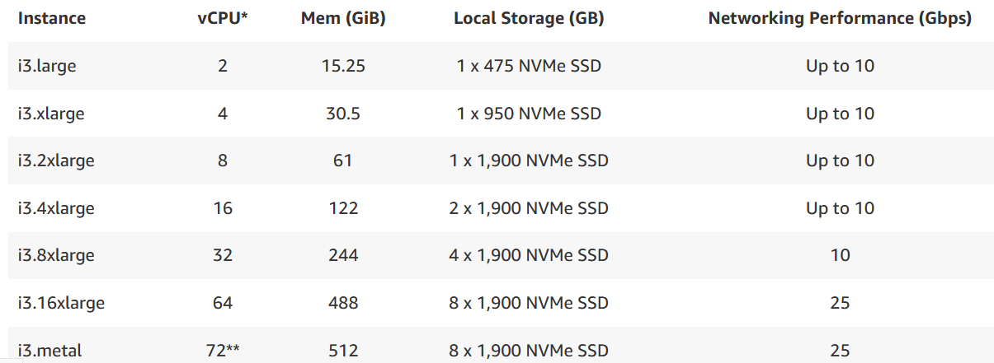
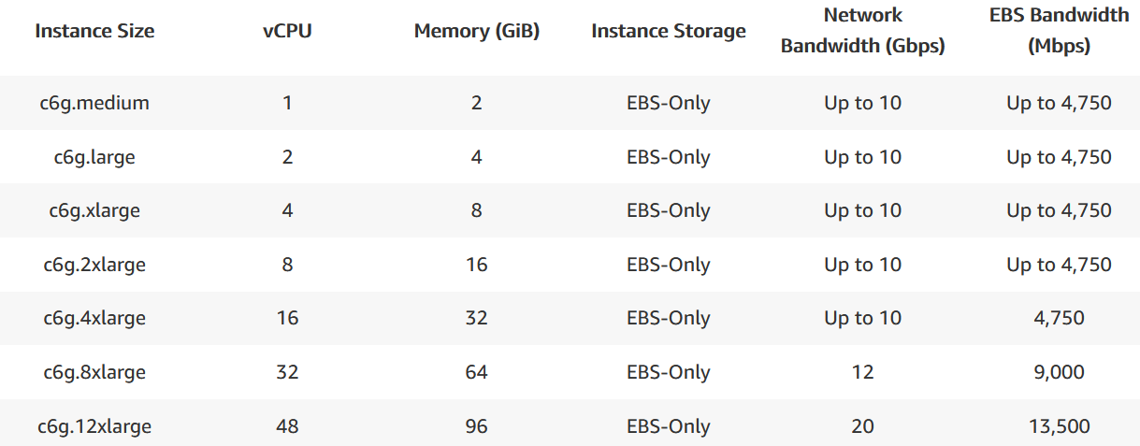
BUILDING BLOCKS: COMPUTE & Network
EC2
Elastic Cloud Container
Instance Types
Instance Families
General Purpose
Compute Optimized
Memory Optimized
Accelerated Computing
Storage Optimized

Slide 22
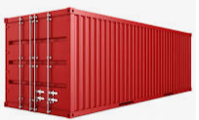


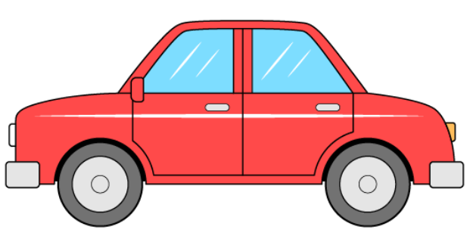
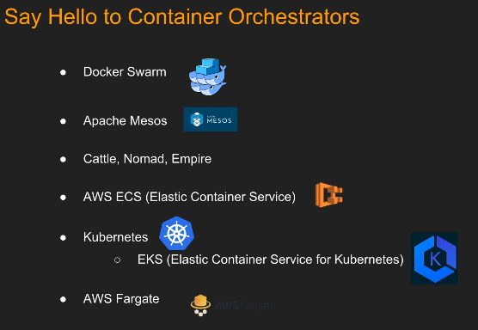
Container Management
Deployment
Redundancy
Scaling Up or Down
Load Balancing
Health Monitoring
REQUEST
Monitor the health of
all container replacing
them as they die and
killing and replacing
once sick enough
Get code/environment info
Copy to working memory
Start Container
Logging Activity
Deploy more than one of
same container type
Configuring Load Balancing -
point to other instance in
container in case of failure
or purpose
Decide which container
should gets the traffic
and route it accordingly
Scale DOWN
for less traffic
Scale UP
for MORE traffic

Slide 23
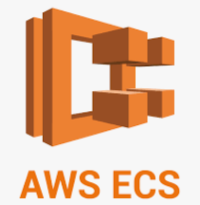
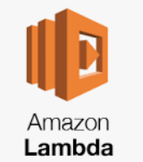
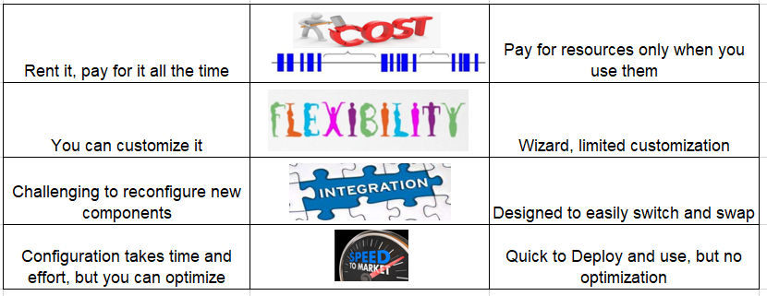
ECS (Unmanaged) vs Serverless (Managed)

Slide 24
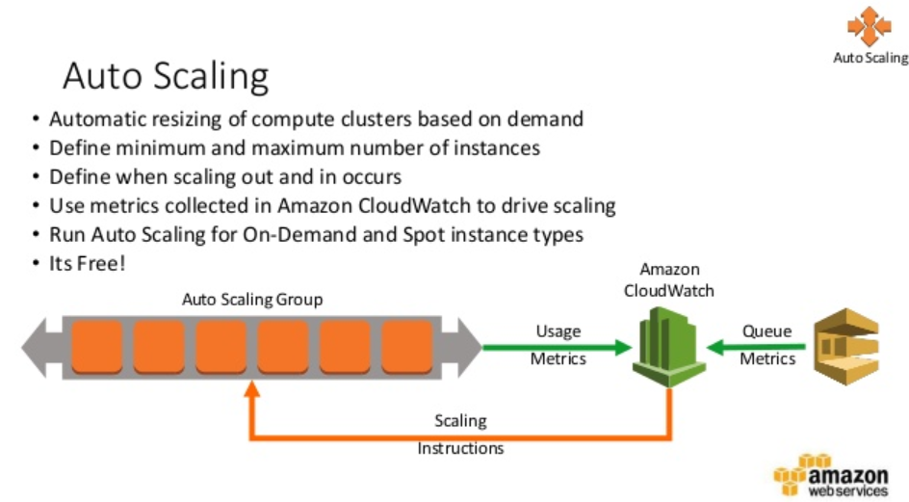
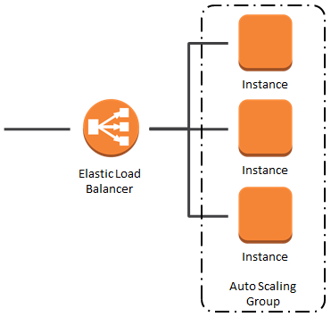
Concept of Auto Scaling/Load Balancing
Load Balancing
After you have scaled, you
Must distribute/load balance
for that scaling to be effective
Example:
Amazon RDS
Amazon RDS
replica

Slide 25





AWS Building Blocks: Microservices
Microservice - small, independently-running applications that perform a single function for a larger application or IT infrastructure. By loosely connecting a number of them together, developers create a pluggable architecture that facilitates the process of updating, upgrading, and scaling the application in response to changing requirements.
Put the microservice in the “cloud”
Have it communicate back
To your Monolithic application
File Ingestion
AWS S3
File Processing
OR
Candidates for
Microservice
AWS Elastic Transcoder
AWS Lambda
File Publishing
AWS CloudFront

Slide 26




AWS Building Blocks:Microservices
INTRODUCING Simple Queueing Service (SQS)
Would be remiss
If I didn’t mention
DLQ
COMMON SQS USE CASES

Slide 27

AWS Building Blocks:Microservices
Introducing Simple Notification Service (SNS)

Slide 28

Building Blocks: AWS MicroServices

Slide 29

MicroServices: Introducing Streams
Most AWS
Storage
Objects
Create
Retrieve
Update
Delete
CRUD Event creates a stream
Kinesis picks up stream and passes it to AWS Lambda
Lambda determines source and applies the correct function and runs it
Amazon uses Streams to replicate changes in other AZ Eventually consistent vs Strongly Consistent
Streams are used for most AWS objects
and are particularly used
with DBs and IoT
Streams available for 24 hours then purged

Slide 30

Architecture example in motion
6. Rekognition association added to S3 Meta Data “Taylor Swift”
4. SNS topic invokes Lambda
2. Lambda invoked
off S3 event stream
3. Retrieves/Processes file
from S3
Returns thumbnail to S3
Adds task to SNS

Slide 31













ReCAP
Saas, PaaS, Iaas
Tools to Access AWS
Regions, AZ and DCs
Containers
Storage
AWS Databases
COMPUTE/Network
Services and Apps
AS and LB
Streams
Managed/Unmanaged
Example
SQS
SNS

Slide 32
Building Considerations
Managed or Unmanaged
Where/How to Deploy It

Slide 33



Managed vs UnManaged Services
Unmanaged
Managed
Its all on you to manage
AWS manages it for you
Why choose a managed service?
You don’t have to worry about backup
You don’t allocate diskspace shortage
You don’t build servers
You don’t handle infrastructure to expand
You don’t have to patch OS, Firmware
You don’t have to worry with UPS (power)
You don’t have to worry about scaling
You don’t deal with Physical security, racking, HVAC
You don’t deal with network redundancy
You don’t have to do application patching
You don’t deal with purchasing HW
You don’t have to build monitoring infrastructure
You don’t have to hire staff to manage it
You don’t have to worry about fault tolerance, or resiliency
Lambda

Slide 34

Deployment Architecture
What is a Private Cloud?
What is a Public Cloud?

Slide 35


ARCHITECTURE EXAMPLES:
Private Cloud
Hybrid Network – half local/half cloud
Could be entirely Private network, Half Private/Half Public network
SMS Notification Engine
Event_type =
Send SMS notification
All Cloud

Slide 36



Simple Architected Solutions
User modifies content of
S3 bucket
Application monitoring S3
is notified and has option
To post a change or delete

Slide 37







Lift and Shift Example
Ingest
Update SAP
Process
Publish
Publish File
.\Ingest
.\Processed
.\Published
.\Ingest
.\Processed
.\Published
.\Ingest
.\Processed
.\Published
Many enterprise cloud teams have been delivering on aggressive timelines in so-called “lift-and-shift” cloud migrations, where the goal is to move a specific set of applications to the cloud as fast as possible without changing their core architecture, functionality, or performance characteristics.
Processed

Slide 38
Deliver/Deploy To Cloud
SLDC
CI/CD
DevOps
Tools to Deliver/Deploy to Cloud
Serverless
Infrastructure as Code – Applications and Services
Configuration as Code – Applications
Deployment Strategies
All at once/In Place
Rolling Deployment
Configuration as Code – Applications

Slide 39








SLDC & AWS DEPLOYMENT TOOLS
SLDC
CI/CD (continuous integration/ continuous delivery)
Consider this with Concept of DoD (Definition of Done ) from the Scrum world
DEVOPS – the process of automating CI/CD (or the group handling it)
AKA Continuous (automated) Deployment
Combines CI/CD with tools like AWS Config and Infrastructure as Code tools
Deployment Tools
CI/CD Tools

Slide 40










InfraStructure as Code (IaC)
AWS CloudFormation – uses generate templates to deploy infrastructure
Stacks, AutoScaling Groups, Domains, DB Clusters, CertificateMgmt
Its not just your application you are delivering, its also the infrastructure (AS/LB, AWS interaction behind it
Deployment Tools
Configuration as Code
AWS OpsWorks – Tools to Deploy Applications
Chef & Puppet rolled up together for AWS
AWS CodeDeploy
Elastic BeanStalk
Amazon ECS
Non AWS Equivalent
Non AWS Equivalent
CI/CD Tools
CI/CD Tools

Slide 41




Deployment Strategies
All-At-Once / In-Place*
Partial Deployment
Instance 1
1a
Stop old
Instance 2
1b
Start new
Multiple Instances
Stop old
Start new
*generally for On-premise installs and single instance

Slide 42




Rolling Deployment
Old instances are phased out and replaced with new instances until old instances no longer exist. A phasing out of one with another
T0
T1
Tn
. . .
Variation - Rolling Deployment with Additional Batch
Additional batch leaves old instance(s) dormant (not running) eventually removing after designated time allowing easy rollback
T0
T1
Tn
Tn+1

Slide 43

Canary Deployment Strategy

Slide 44



Blue Green Deployment Old (Blue) & New (Green) instances both deployed simultaneously . Flips traffic to all new instances at once via DNS. If it fails, flip it back

Slide 45
Security: Authentication and Authorization
AWS Shared Responsibility Model
IAM Management
SSO and Federation

Slide 46

Shared Responsibility Model
“IN” THE CLOUD
“OF” the CLOUD

Slide 47

Identity and Authorization Management
TRUST POLICY - Who
EXECUTION POLICY - What
*
IAM - Identity Access Management

Slide 48




AWS Security
Identity, Resource and Session Security
Network Security
Session Policies
Access Control List (ACL)
-
Advanced policies that you pass in a parameter when you programmatically create a temporary session for a role or federated user.
Security Groups
Like ACL but at instance level
Explicit Deny
Least Privilege

Slide 49





How Federation Works: Authentication Source is different than owner
How AWS SSO Works:
AD On Prem & AWS SSO (same owner)
Supports MFA
SSO – Single Sign On

Slide 50
Monitoring, Troubleshooting and other Exam Extras
Monitoring and Troubleshooting Tools
Cost Management Tools
Instances Types
AWS Well Architected Tool/Model

Slide 51




Monitoring and Troubleshooting
CloudWatch
Built-in metrics –(ie CPU usage, network % utilization for example)
Custom metrics (count of open custom objects)
Alarms that can drive events like AutoScaling instances
CloudTrail
Records ands monitors API calls
AWS X-Ray
Works with Lambda to track and measure events or workflows
Useful to identify performance bottlenecks, identifying errors and impact to users
AWS CloudWatch
AWS CloudTrail
AWS X-Rau

Slide 52

Cost Management & other related tools
From AWS Mgmt Console
AWS Organizations –manage multiple AWS accounts, and consolidated billing, discounts
AWS Cost Management Tool – allows you to view most granular data on your AWS bill
AWS Explorer – easy to use interface that lets you analyze costs/usage over time
AWS Budgets – allows you to set up alerts when account approaching certain dollar amt
AWS Marketplace – third party software written for AWS that you can one-click install/use
AWS Trusted Advisor –automated tool providing recommendations on cost optimization,
performance and security
AWS Config – maintain auditable history of configuration changes
AWS Total Cost of Ownership (TCO) – tools to isolate cost of putting customer workload
currently not on AWS to being on AWS (on-Prem or hosted elsewhere)
Amazon Inspector – automated tools for security and complaince
AWS Artifact – your go-to resource for compliance: reports, agreement, security audits
Note: You need a differential understanding of what these tools do for the Certified Practitoner exam

Slide 53
Instance Types and Related Info
You require a perfunctory understanding of this for the Certified Practitioner exam.
Dedicated Hosts
On Demand Instances (default)
Spot Instances
Reserved Instances
Convertible Instances

Slide 54


AWS Well Architected Framework

Slide 55
AWS vs Red Hat
Big Takeaways
Service Comparison
Instances Types
AWS Well Architected Tool/Model
General Comparison of AWS and Azure and Google Cloud

Slide 56

AWS vs Red Hat Takeaway
1)Red Hat OpenShift is comparable to AWS Kubernetes products
2)Red Hat is Cloud Agnostic – AWS is AWS Centric
Uses Docker Enginer or Kubernetes
3)There are competing product lines between the two products
4)Red Hat is geared for MultiCloud, AWS – geared for AWS
5)OpenShift can operate in AWS, Google, IBM Cloud, all clouds. AWS operates primarily in AWS

Slide 57

AWS vs Red Hat – Service Comparison

Slide 58
Tools
AWS Red Hat
Management Console Satellite
ECS or EKS Openshift
API Gateway Ambassador
Auto Scaling Orchestration
CloudWatch Telemetry
Openshift is really a CaaS (Container as a Service) offering and layered over Kubernetes.
Whereas AWS EKS and ECS are managed services (so yes, PaaS).
If you need to DIY (do it yourself) or have functionality closer to native Kubernetes and want to manage your own cluster
(or required to do so for various compliance reasons), then Openshift distributions (whether OCP - this costs more
due to Red Hat support; or OKD - completely free and open source) from Red Hat are very good CaaS solutions.
If your project compliance and costs allows cloud service providers (like Amazon in this case, or even Azure in other cases)
to host your containers using the CSP managed services, then AWS ECS or EKS are fine solutions too in those cases.
https://www.gangboard.com/blog/aws-vs-openstack
https://www.itcentralstation.com/products/comparisons/amazon-aws_vs_openshift
https://w3-connections.ibm.com/wikis/home?lang=en-us#!/wiki/Wf58c4c538dbf_45b4_b7a7_5003d0ceb79b/page/Competitor%20-%20Amazon%20AWS

Slide 59


AWS vs Azure AWS vs Google Cloud
Source: https://www.differencebetween.net

Slide 60
AWS Certifications
4 Levels of Certifications
Practitioner
Associate
Professional
Specialty
Considerably more difficult as you go up the hierarchy

Slide 61

AWS Education Journey

Slide 62
APPENDIX: BONUS MATERIAL
BIG DATA: Data Lake vs Data Warehouse vs Data Mart
DATA LAKE – think of a universe of data relating to many entities – Several Data Warehouses along with Unstructured Data
DATA WAREHOUSE – think of a warehouse storing a variety of different, but related to entity (Corporation (Multiple Entities) Accounting Data (Several Data Marts)
DATA MART – think of a specialty store, carrying all the same related items (One Companies ERP Accounting Data)
Journey To Cloud USING AI to GET VALUABLE INFO

Slide 63


Data Lakes, Data Warehouses and Data Marts
ETL – Extract, Transform, Load

Slide 64

Journey to Cloud: Transitioning Data to the Cloud
Structured Data
Event log analysis can reveal undesired security breach attempts
Can help prevent big problems by listening for little ones
Unstructured data
Majority of data grows faster than any other type of data
A large portion of big data sources is unstructured.
AI weaves value from unstructured data
Semi-Structured data
Phone conversations from support
IoT reads your corporate vehicle reports
AI weaves value from unstructured data
Unstructured Social media, Emails, videos, business documents,
and other forms of text are among the best sources and examples of unstructured data.
Source: https://www.i-scoop.eu/big-data-action-value-context/unstructured-data/

Slide 65

Unstructured Data: What can we learn?

Slide 66
Unlock Significant Benefits
Beneficial insights into business operations, such as awareness into areas such as customer purchase patterns, transaction preferences, and timing of order placements. Ie Most purchases are done on Wednesday or weekend before Memorial Day
Comprehensive Customer trends, marketing trends, consumed time, overall interest level, co-related events:
Ie Timeline from Sales Announcement to Revenue Stream of product, sales campaign
or Timeline of News announcement to stock price or relation
Full visibility into each content area of the transaction provides an accurate snapshot of processes and knowledge of whether customer expectations are being fulfilled.
Ie Batting avg .323, but .788 when men on base
Reorder frequency vs email/support traffic between you and customer
Distributors can gain insight into where bottlenecks are and identify the accounts that are within profit forecast. Ie Deliveries take longer from x vendor, or same for various shipper.
Trending and/or alerting of price increases to notify you to renegotiate or transition supplier
With a comprehensive summary of information, such as time spent by employees serving customers, distributors can target resource inefficiencies.
(Ie amount of email mentions of Project Z may suggest not enough/too many hands involved
Knowledge from unstructured data into how customers progress through stages
of the purchasing funnel can also help distributors design programs and incentives that aid with the satisfaction and, most importantly, the retention of these customers.
Bring awareness of repeated security event based on attempts to same or different endpoints by having consolidated event logging.
Ie identifies that Hacker starts at factory A probing, then moves to factory B, allows Security to just deny traffic or to further scrutinize
Graphics source: : https://www.ibmbigdatahub.com/infographic/where-does-big-data-come

Slide 67
USING COGNITIVE AND AI WITH BIG DATA
Example: System Record Analysis - Workflow
Time from start to finish for a business loan or solve a problem
Example: Social Media Influence (time sensitive)
News hitting airwaves, how it affects people’s searches, purchases - Psychology
Commercial product introduction – how much time (interest) spent
Example: Email System/Audio Files of Cust Support
Determining how much effort (quantity of emails) around a project
Penetration of BISO message to employees
Determining what the issues are and confirming it with what CSRs are collecting, drive product development and support
Example: Hidden value in data mining multiple sources
Ie Batting avg .230, but .788 with men on base
Customer more apt to buy on Wednesday or certain date/times of month/year
All State of the Union addresses for topical outline of historical events

Slide 68


AWS and BIG DATA
AWS EMR (Elastic Map Reduce) – cloud big data platform for processing vast amounts of data using open source tools. Performs ETL
AWS Redshift -a fast, fully managed cloud data warehouse that makes it simple and cost-effective to analyze all your data using standard SQL and your existing Business Intelligence (BI) tools. It allows you to run complex analytic queries against terabytes to petabytes of structured data, using sophisticated query optimization, columnar storage on high-performance storage, and massively parallel query execution.
AWS Athena - is an interactive query service that makes it easy to analyze data in Amazon S3 (unstructured) using standard SQL.
Unlimited Storage Capacity – which is why other BIG DATA players use AWS as storage platform for their AI and Cognitive engines
An up and coming BIG DATA with multi cloud BI platform for AWS, Azure and others
a world AI leader in the BIG DATA BI, processing/data analysis field

